Slide 1
CSSD 204: Scripting Languages INTRODUCTION TO SCRIPTING LANGUAGES
By Augustus Buckman

Slide 2
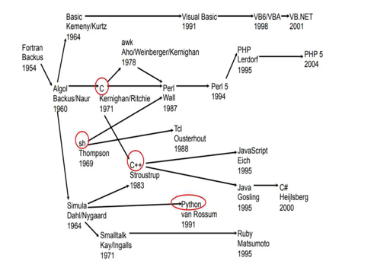
History of Languages

Slide 3
Introduction
Scripting languages and system programming languages are complimentary
Most major computer platforms since the 1960s include both kind of languages
Several recent trends, such as faster machines, graphical user interfaces (GUI) and the growth of the internet, have greatly expanded the applicability of scripting languages

Slide 4
Why Should You Care?
Python is the #1 language for data science, AI, and automation — all scripting
JavaScript powers every modern website and most mobile apps
Bash and PowerShell scripts save system admins hours of manual work every day
DevOps, cloud infrastructure, and CI/CD pipelines all run on scripting languages
Understanding scripting vs. system languages helps you pick the right tool for the job

Slide 5
What is Scripting?
Scripting is the process of programming using a scripting language
A scripting language, like C, Fortran, and Java, has expressions, conditional statements, and loop statements.
Unlike C, Fortran, and Java, a scripting language has
+ Loose typing
+ Interpreted rather than compiled
+ Usually as some higher level abstractions or built-in functionality

Slide 6
Origin of Scripting
The use of the word ‘script’ in a computing context dates back to the early 1970s, when the originators of the UNIX operating system created the term shell script for sequence of commands that were to be read from a file and follow in sequence as if they had been typed in at the keyword.
The name ‘script’ being used for a text file that was intended to be executed directly rather than being compiled to a different form of file prior to execution.
Scripts only become interesting when they have the added value that comes from using programming concepts such as loops and branches

Slide 7
Generalizations About Programming Languages
Introduced as an alternative to assembly language
Provide “higher level” instructions
1 line of code ~ 3-7 assembly instructions
Are strongly typed- The “type” determines how data can be used
+ Can catch errors at compile time
Example: using a floating point instead of a pointer
+ Can make large code bases more manageable
Clarify how things are used
+ Compiler can use type information to generate more efficient code
Example: can generate integer instructions

Slide 8
Generalizations About Scripting Languages
Interpreted (some compiled internally)
Rapid development - no compilation required
Portability - cross platform (since not compiling - no machine code)
Slower than compled languages
Frequently no “main”
Good for controlling and connecting other applications
Flexibility
+ Easy to extend
+ Vast libraries and extensions available

Slide 9
Differences between Scripting Languages and Programming Languages
Some programming languages traditionally used with an explicit compilation step are C, C++
Applications of Scripting Languages
To automate certain tasks in a program
Extracting information from a data set
Less code intensive as compared to traditional programming languages
Applications of Programming Languages
They typically run inside a parent program like scripts
More compatible while integrating code with mathematical models
Languages like C++ can be compiled and then used on any platform

Slide 10
Scripting Languages vs System Languages
Scripting Languages | System Languages
Higher level | Lower level
Gluing components | Building components
Loosely typed | Strongly typed
Intepreted | Compiled
Runs slower | Runs faster
Faster development | Slower development
Dynamic code | Static code
Smaller code size | Larger code size

Slide 11
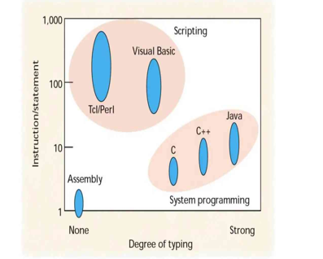
Scripting Languages vs System Languages

Slide 12
Common Characteristics of Scripting Languages
Both Batch and Interactive use
Economy of expression
Lack of declarations; simple scoping rules
Flexible dynamic typing
Easy access to other programs
Sophisticated pattern matching
High-level data types

Slide 13
Common Characteristics of Scripting Languages
Batch and Interactive Use
Perl has a JIT compiler that reads the entire program before execution
Other languages are quite happy to only execute a line as soon as it has been read
Python, TCL and Ruby will also accept commands from the keyboard

Slide 14
Common Characteristics of Scripting Languages
2. Economy of Expression
To support rapid development and interactive use, scripting languages require very little boilerplate code
This can be illustrated very clearly by the following example:
public static void main(String args[])
{
System.out.println(“Hello!”);
}
print “Hello!/n”
Another example is reading a file word by word

Slide 15
Common Characteristics of Scripting Languages
3. Lack of declarations and simple scoping rules
Most scripting languages dispense with declarations
They also use simple rules to govern the scopes of names (identifiers)
In Perl, every name is global by default
In Tcl and PHP, everything is local by default
Python has a unique implementation in that any variable that is assigned a value is local to the block in which the assignment appears
Special syntax is required to access the variable from a surrounding scope

Slide 16
Common Characteristics of Scripting Languages
4. Flexible dynamic typing
Most scripting languages are dynamically typed.
In PHP, Ruby, Python, the type of a variable is checked immediately prior to use
In others such as Tcl and Perl, a variable can be interpreted differently in different contexts.
E.g.
$a = “4”
print $a. 3. “/n”
print $a + 4 . “/n”

Slide 17
Common Characteristics of Scripting Languages
5. Easy access to other programs
Most programming languages provide a way to interact with the underlying commands of the OS
However, this can be quite convoluted, as anyone who has had to do work with the Runtime.exec command knows
Scripting languages support these OS commands and their outputs much more cleanly and directly
Perl outputs 100 built-in commands for the OS while the os mdoule in Python is an excellent library for executing commands

Slide 18
Common Characteristics of Scripting Languages
6. Sophisticated pattern matching
As scripting language ancestors were used for text processing, the support for pattern matching in text files is impressive
Scripting languages have very good facilities for pattern matching, searching and string manipulation
This is all based upon the notion of extended regular expressions
sed is a powerful scripting language for text processing.
What does sed ‘1!G;h;$!d’ do?

Slide 19
Common Characteristics of Scripting Languages
7. High-level data types
High level data types such as sets, bags , dictionaries, list and tuples are some of the very convenient features provided by scripting languages
In C++, it is possible to use “operator overloading’ to create advanced user-defined types but scripting languages go one step further by building high-level types into the syntax and semantics
E.g in Python, a dictionary can map a key to a value
dict([(x, x**2) for x in (2,4,6)])
{2:4, 4:16, 6:36}

Slide 20
Scripting Languages
Simple command/shell scripting, level 1, is the simplest form of scripting
Intended to provide a “batch” execution capability
Unix/Linux
+ bash, ksh (Korn shell), sh (Bourne shell)
+ csh (C shell), tsch
+ These shells can work interactively or in script mode
+ Have basic programming constructs (if, loops,...)
Windows
+ cmd/command have no programming constructs
+ Windows PowerShell (4Q2006) will have extensive scripting based on C# language

Slide 21
Scripting Languages
Limited scripting languages, level 2, have more sophisticated language structure but are limited in their native functionality
+ No native file I/O capability for example
JavaScript / Jscript / ECMAScript
+ Available on Unix/Linux and Windows
+ C based syntax
+ Used almost exclusively as the client-side scripting language in the various web browsers
+ Can be used as a system scripting language in Windows via the Windows Scripting Host
+ Not generally used in Unix/Linux for general purpose scripting
+ SpiderMonkey is C based JS interpreter
+ Rhino is Java based JS interpreter

Slide 22
Scripting Languages
Full scripting languages, level 3, have a sophisticated language structure and extensive application support
Perl — Practical Extraction and Reporting Language
+ A procedure based language with support for objects
+ Extensive text processing capabilities and regular expressions
+ Extensible using modules
+ C based syntax with plethora of symbols
+ Developed in late 1980’s
Python (also Jython)
+ An object oriented language with some procedure traits
+ Extensible
+ A format based syntax
+ Developed in early 1990's

Slide 23
Scripting Languages
Other niche scripting languages
+ BeanShell
Makes it possible to use Java as a scripting language
+ REXX
C-like, objects, cross-platform, has a Java version

Slide 24
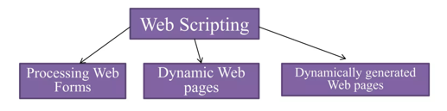
Web Scripting
Web scripting refers to the process of creating and embedding scripts in a web page to automate tasks, generate dynamic content, and respond to user interactions. Scripts are lists of commands that are interpreted and executed by a web browser or server

Slide 25
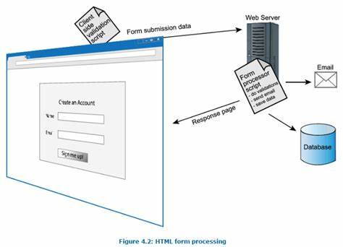

Processing Web Forms

Slide 26
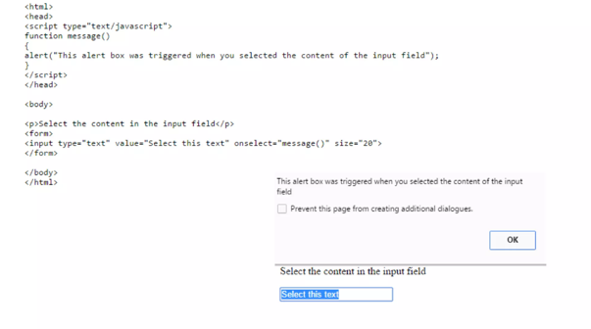
Dynamic Web Pages
DHTML is about creating web pages that reacts to user events
DHTML is about using JavaScript and the HTML DOM to change the style positioning of HTML elements

Slide 27
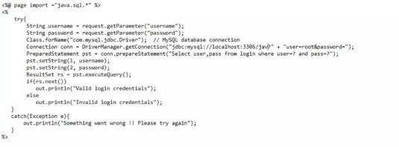

Dynamically Generated HTML
It is another form of dynamic web page in which some or all of the HTML is generated by scripts executed on the server
A common application is to construct a page whose content is retrieved from a database.
Examples: Microsoft IIS Web Server which implements Active Server Pages (which has scripts in javascript or vb script)

Slide 28
Universe of Scripting Languages
There is scripting universe, containing multiple overlapping worlds
The original UNIX world of traditional scripting using Perl and Tcl
The Microsoft world of Visual Basic and active x controls.
The world of VBA for scripting compound documents
The world of client-side and server-side web scripting
Overlapping them is very complex, as web scripting can be done in VBScript, JavaScript, Perl Or Tcl

Slide 29
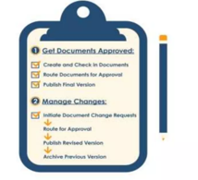
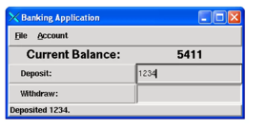
Universe of Scripting Languages
Perl and Tcl are used to implement complex application for large organizations
E.g.
Tcl has been used to develop major banking systems
Perl is used to implement enterprise wide document management systems for leading aerospace companies

Slide 30
Typical Uses of Scripting Languages Including Javascript Include
Image or text rollovers: If the user rolls the mouse over a graphic or hypertext then a text or graphic box will appear
Creating a pop-up window to display information in a separate window from the web page that triggered it. This is useful if the user requires to perform a simple calculation or consult a calendar for inputing dates. This is achieved by embedding ActiveX controls or Java applets into the script
Validating the content of fields: When filling in forms, each field, especially required fields denoted by an asterisk, are validated for correct input. If the field is left blank or incorrect information enteed, then a user message will be generated and you may not continue

Slide 31

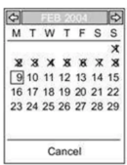

Slide 32
Uses of Scripting Languages
Scripting languages are of two kinds
Traditional Scripting
The activities which require traditional scripting include:
System administration
Controlling remote applications
System and Application extensions
Experimental Programming
Command line interface
2. Modern Scripting
Visual scripting
Scriptable components
Client-side and server side web scripting

Slide 33
The Future
Decline in use of C and C++
An increasing use of dynamic languages
Commercial software development: no compile needed, development and testing is simplified
Scripting languages are likely to become extremely important

Slide 34
Key Takeaways
Scripting languages trade execution speed for developer productivity and flexibility
The core strengths - dynamic typing, pattern matching, high-level data types - make them ideal for gluing systems together
The scripting vs. system language divide is shrinking as hardware gets faster and languages evolve
Knowing when to use each type of language is a critical skill for any software professional

Slide 35
Discussion
Why do you think scripting languages have grown in popularity despite being slower than compiled languages?
In what scenarios would you still choose a system language like C or C++ over a scripting language? Why?
How has the rise of web development changed the role of scripting languages in the software industry?
Do you think the distinction between scripting and system languages will eventually disappear? What trends support your view?

Slide 36
Take Home Assignment
Research Paper: Comparing Two Scripting Languages
Choose two scripting languages covered in class (e.g., Python, Perl, JavaScript, Bash) and write a 2–3 page comparison
Cover their history, typing systems, common use cases, and key strengths and weaknesses
Include at least one code example in each language that demonstrates a meaningful difference between them
Cite a minimum of three credible sources (textbooks, official documentation, or academic articles)
Due: Next class session

